Slide 1
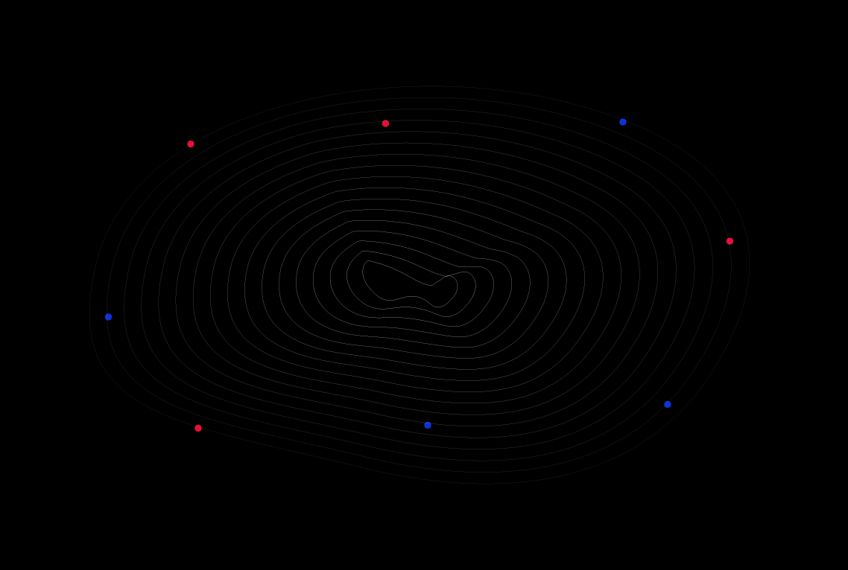
Welcome To
GoMyCode

Slide 2
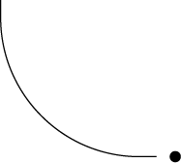

Section 1:
Tools & libraries

Slide 3

Tools & libraries
Tool : Seaborn
Library : Matplotlib
a 2D plotting library that allows you to create publication-quality figures
To install the latest release of seaborn, you can use pip :
$pip install seaborn

Slide 4
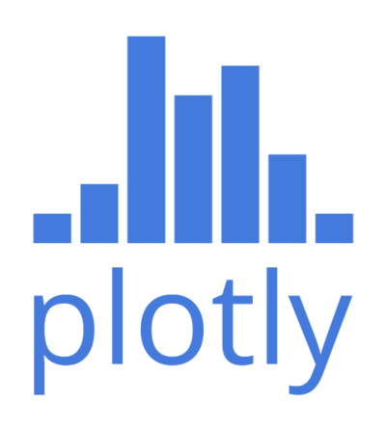
Tool : Plotly
Library : Matplotlib.pyplot
Dash lets you build feature-rich analytic applications in only a few hundred lines of Python
To install the latest release of seaborn, you can use pip :
$pip install seaborn

Slide 5
Let’s get started !
First thing to do is downloading the dataset :
https://google.com
Then we import dataset as following :
Last thing is to import our tools :

Slide 6
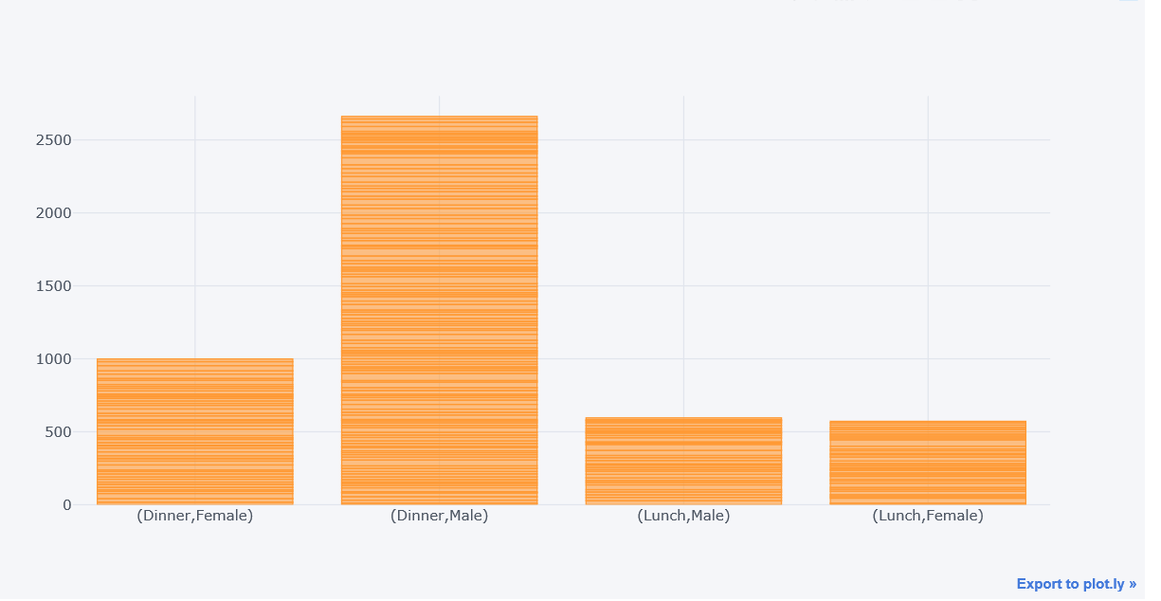
You can see from the output that four bars have been plotted for the total bill. The bars show all possible combinations of values in the sex and time columns.
At dinner male tend to be more than female , yet at lunch male and female are almost the same

Slide 7
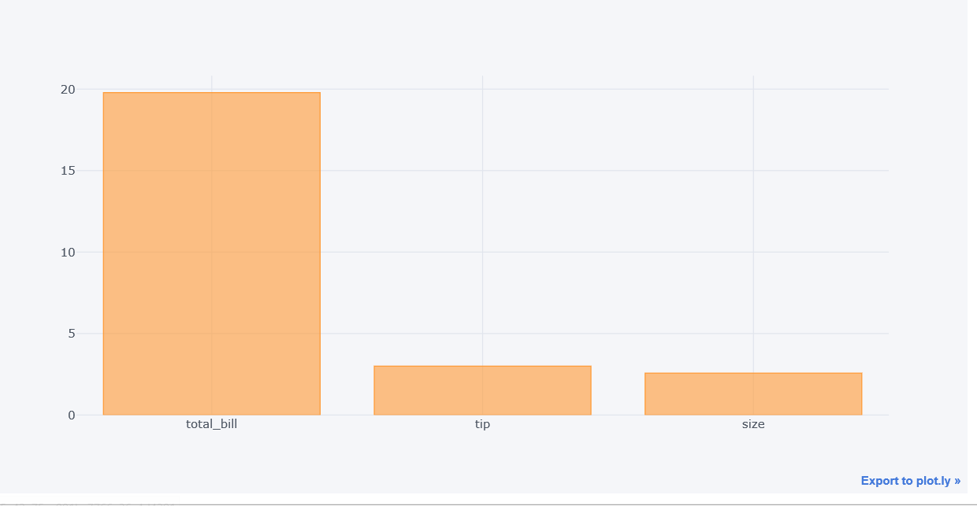
In the output, you can see the bar plots with mean values for total_bill, tip and size column.
Total bill it is almost x5 time greater than the tip
Size and tip are almost the same ( we can say 1$ per person)

Slide 8
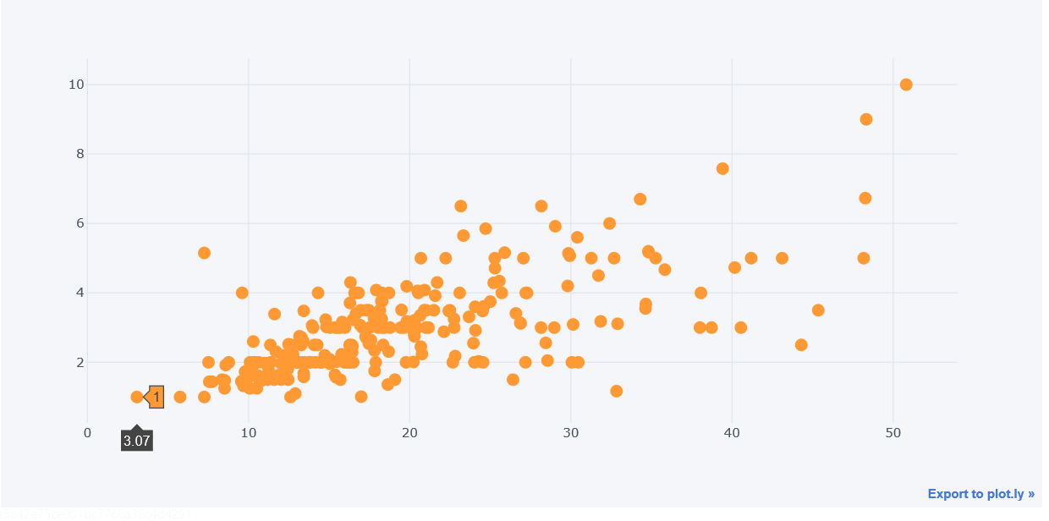
Hover your mouse over the interactive plot to see the changing values for total_bill and tip columns.
Total bill and tip are correlated

Slide 9
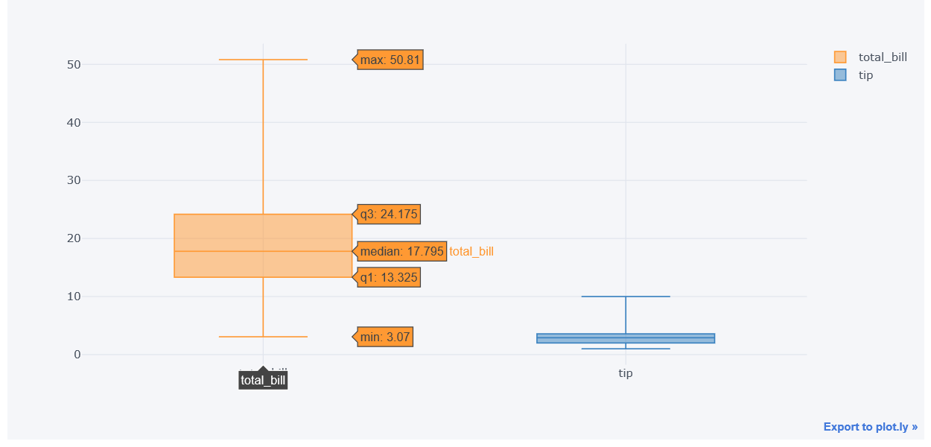
The line at the furthest down represents the lowest value in the data. In this case , the smallest bill is 3.07$
The line at the furthest up represents the highest value in the data. So our highest bill is a whopping 50.81$.
There is no outliers
Our box is symmetric and there is no dispersion

Slide 10
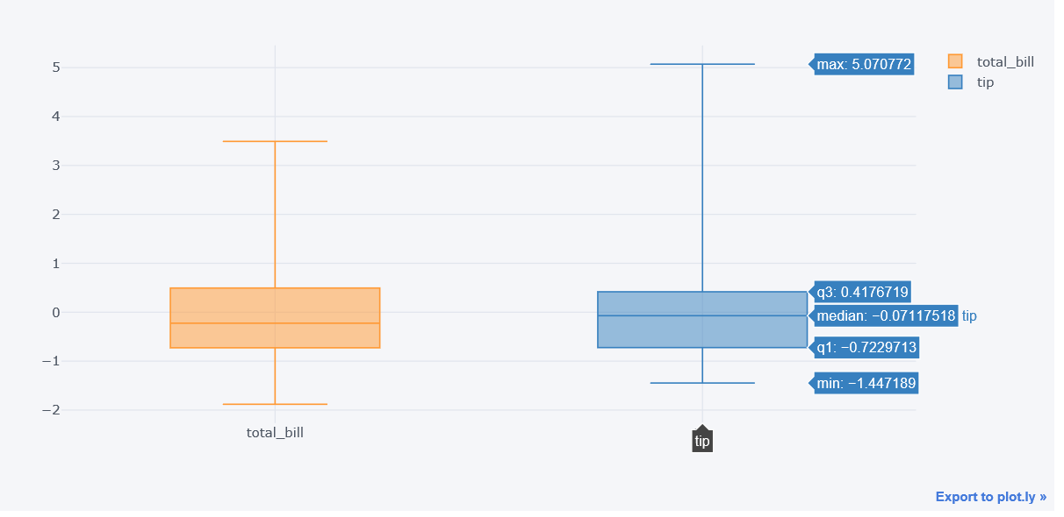

Slide 11
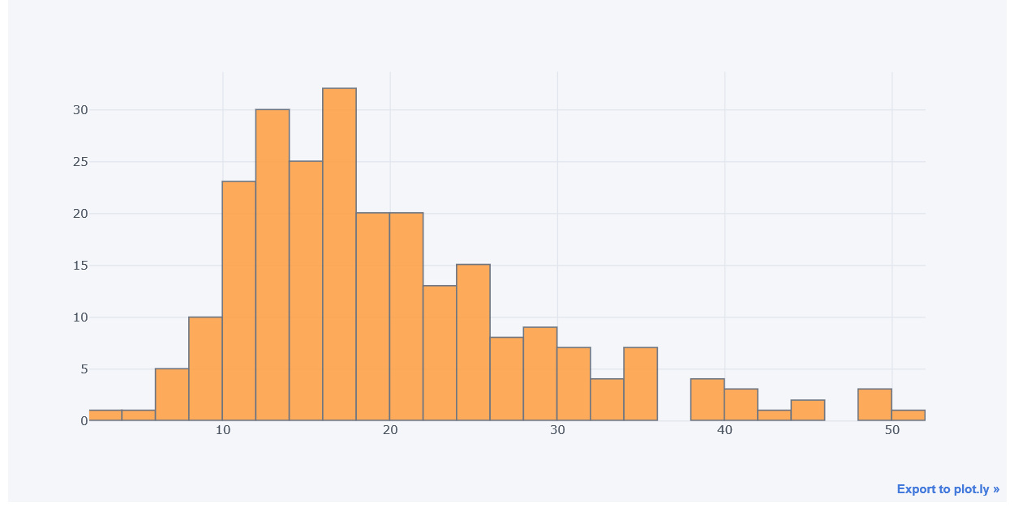
More than 30 people paying a bill between 16 and 18$
None are paying 36 to 38 $ nor 46 to 48$

Slide 12
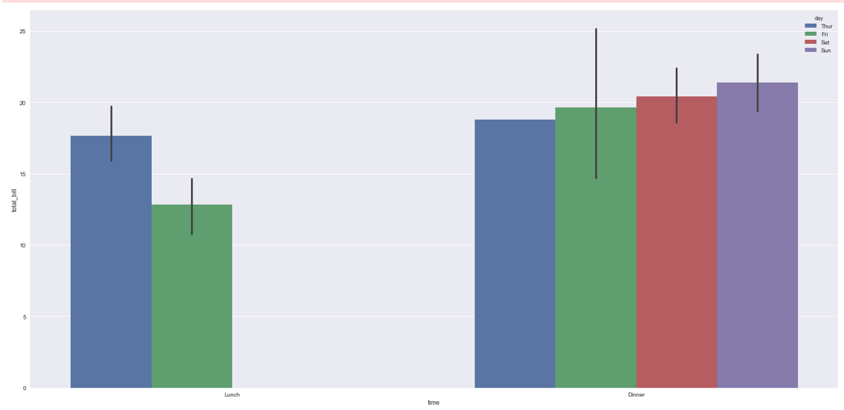
Lunch is only presented on thursday and friday
At lunch on thursday , bills are higher than friday
On sunday bills are higher than all of the other days whether it is at lunch or dinner

Slide 13
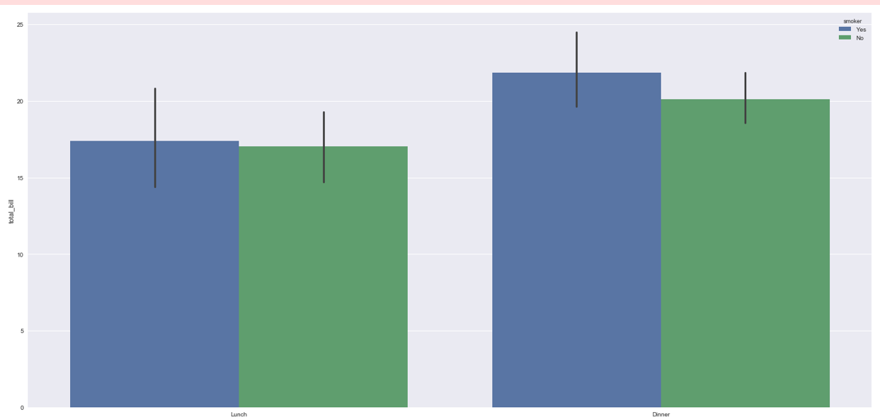
At Dinner Smokers tend to pay more bills than non smokers
At lunch they are almost the same

Slide 14
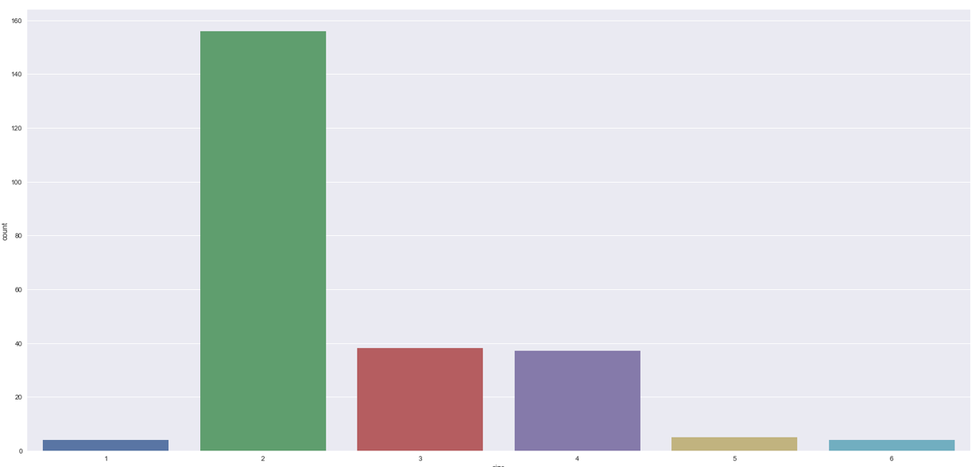
More than 150 people comes as couples followed by 40 as a group of 3 and 4

Slide 15
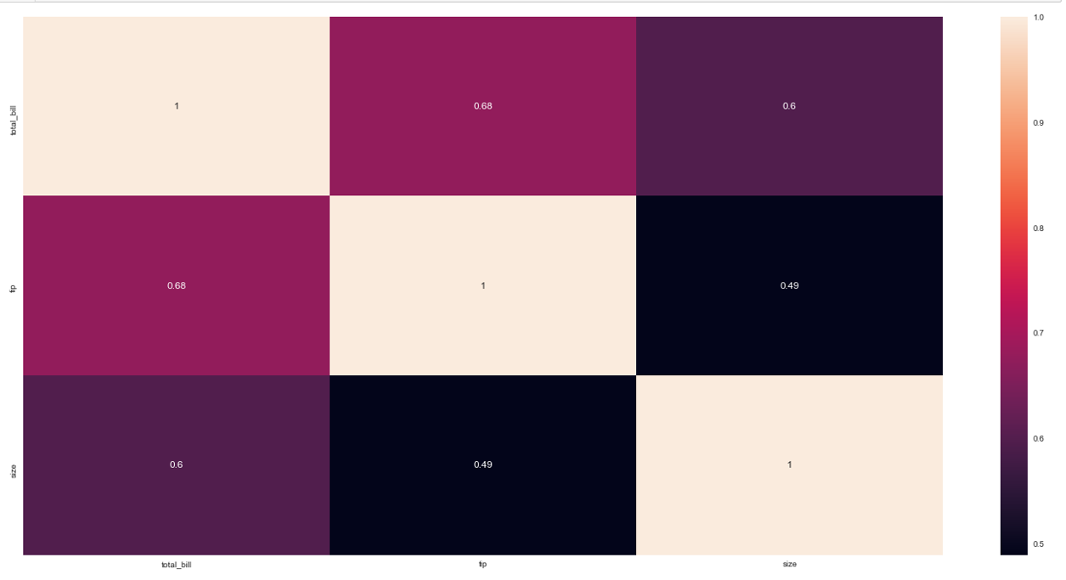
Total_bill and tip are more correlated than total bill and size (068 -> 0.6)
Tip and size are less correlated than all of the other combinations

Slide 16
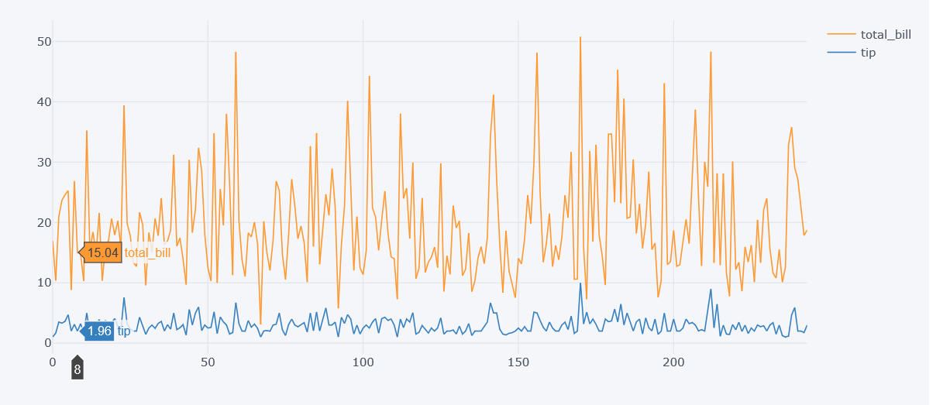
No trend
No seasonality
Total bill and tips have same pattern

Slide 17
Thank You

